Slide 1
Assignment 2 – Predictive Modelling Introduction to Data Analysis (DATA 1200) Prof. Ritwick Dutta
Dheer Parikh
100919437

Slide 2
Introduction
In this assignment we have to create and verify multivariate / multiple regression model for `InfantMortality` for given dataset ‘swiss.csv’

Slide 3
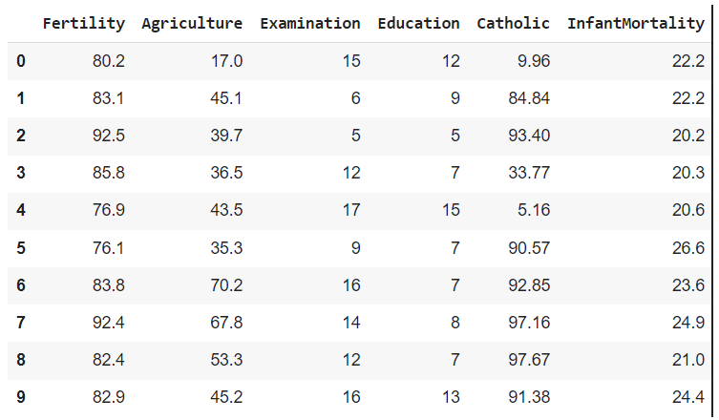
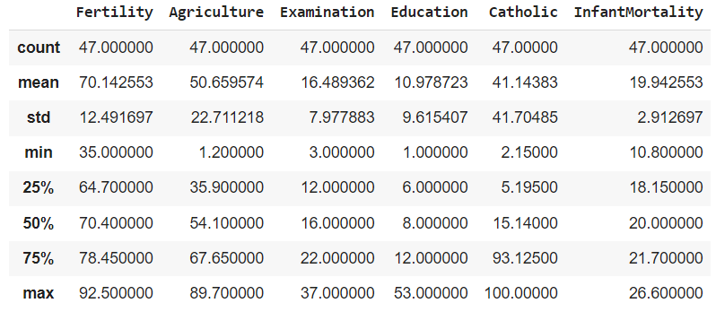
Understanding dataset:
Fig. 1 – first 10 rows of dataset
Fig. 2 – statistical description of dataset
The primary focus of dataset is to find the InfantMortality which means the children who didn’t live upto 1 year after they were born and first 5 features namely : Fertility, Agriculture, Examination, Education, Catholic resembles common standard fertility measures, percentage of males involved in agriculture, percentage of draftees receiving highest marks on army examination, percentage of education beyond primary schools and percentage of catholic peoples compared to protestant respectively.
From the statistical description it can be concluded that nearly half of the total males are involved in agriculture, only 11% are educated people and in terms of cracking exam for army which also includes physical fitness, the mean score among the studied people is just 16.49%. The average fertility rate is 70.14% which is a very good sign and nearly 41.14% people are catholic. After taking all the independent features in account the average Infantmortality is nearly 20%, which means out of 100 babies born, 20 of them dies before they turns a year old.

Slide 4
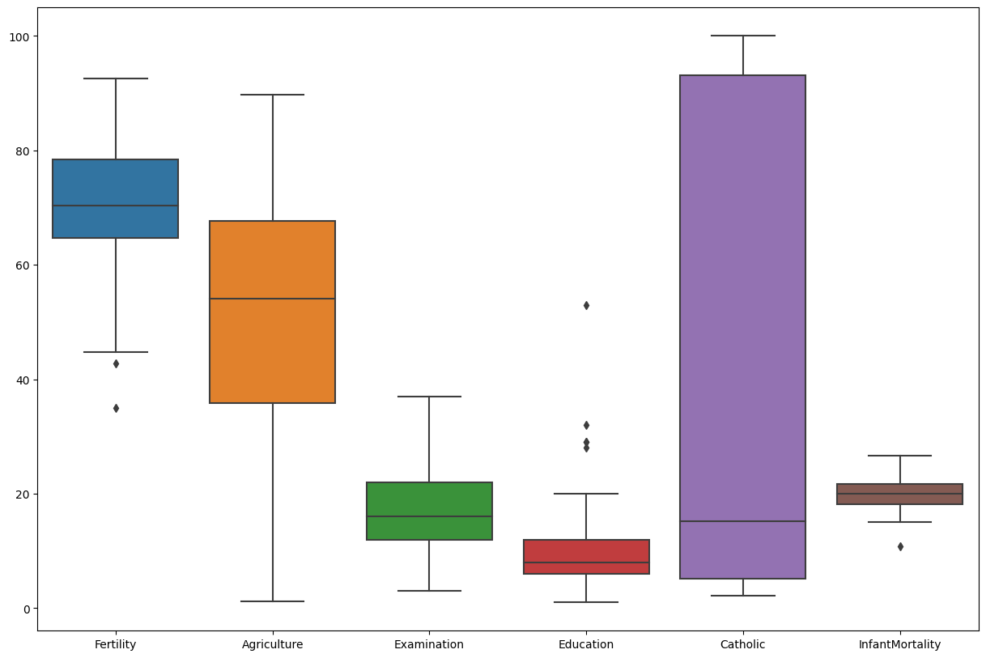
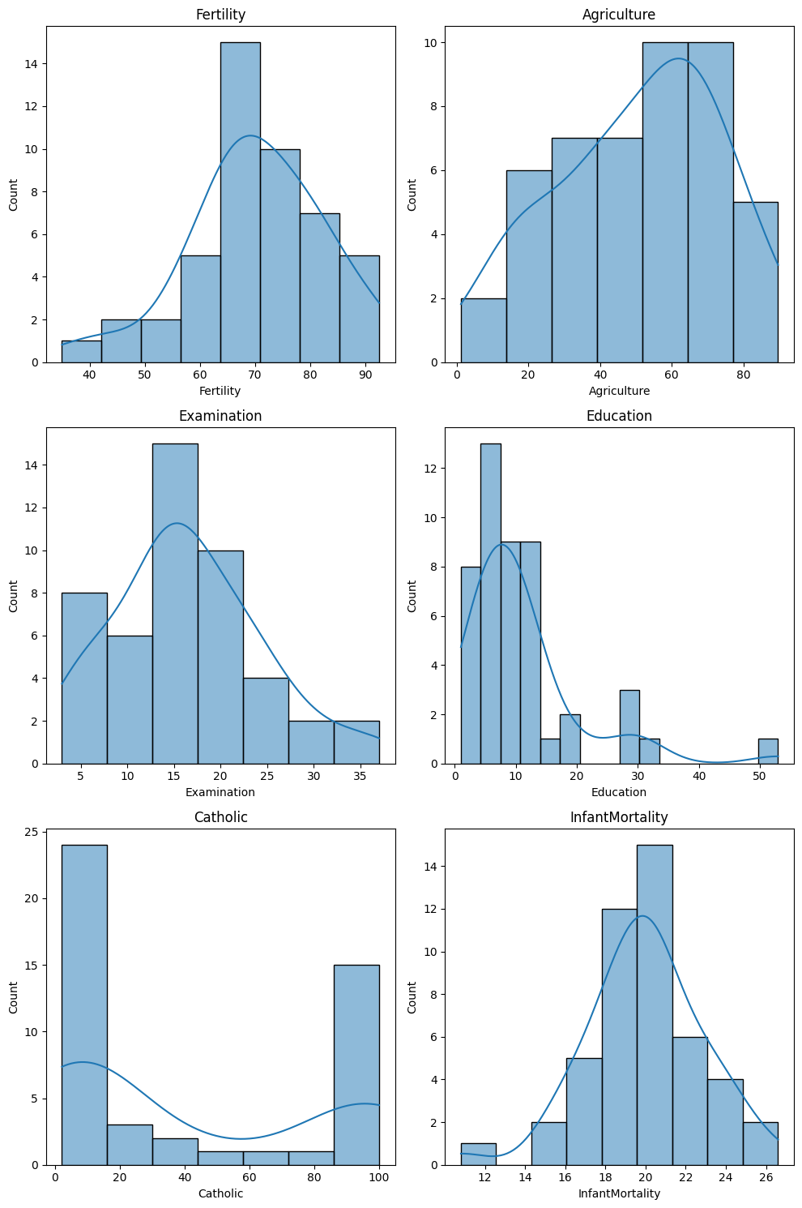
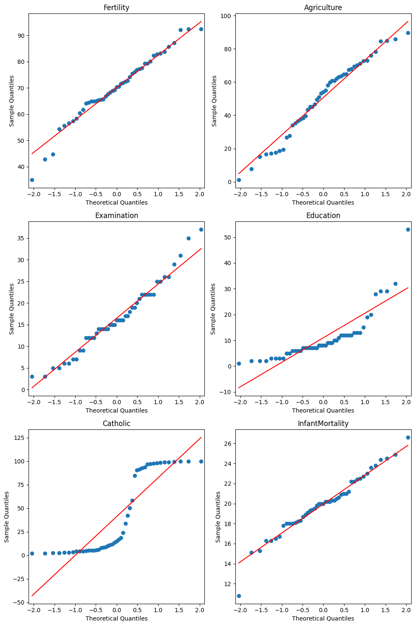
Distribution of dataset:
Fig. 3 – boxplot
Fig. 5 – histogram
It can be seen for the boxplot of fertility that there are some outliers, but they might not be as in some area there can be low fertility and at that places, further analysis should be carried out to increase the fertility. In terms of distribution it has is very slightly right skewed
The distribution of Catholic seems like it follows binomial distribution.
In education, there are some outliers and it has left skewed distribution.
Whereas, in Agriculture, there are no outliers and it follows slightly right skewed distribution.
When talking about examination the distribution is slightly left skewed with no outliers.
In InfantMortality there is one outlier but it may be possible that the it is really low in that region and in that case that region should be studied properly, the distribution of InfantMortality is Normal distribution.
Fig. 4 - QQplot

Slide 5
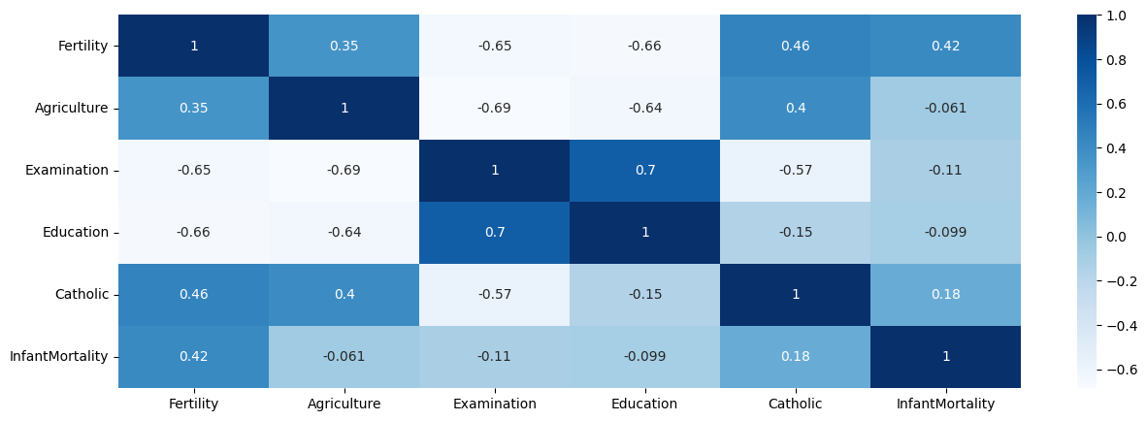
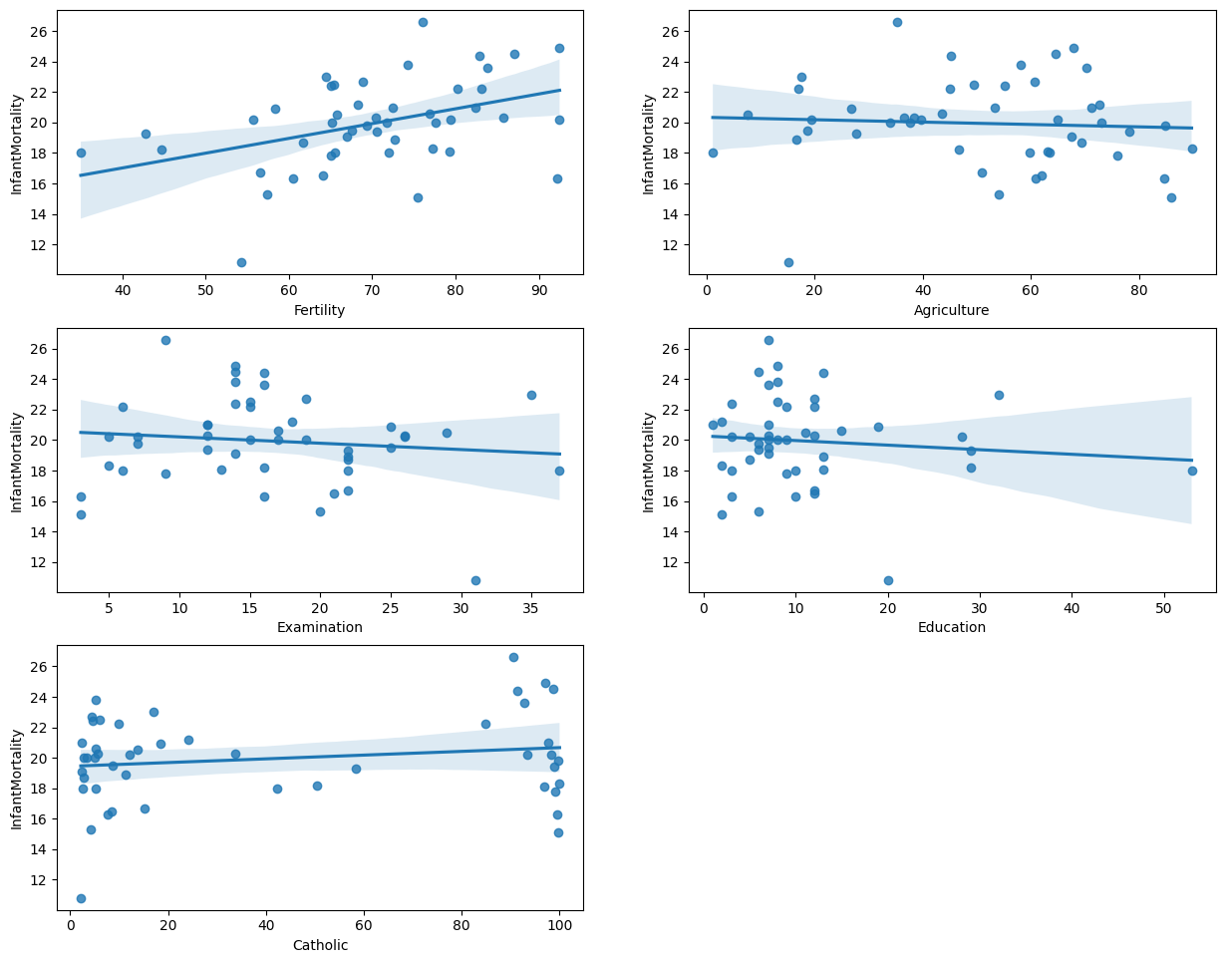
Understanding Correlations:
Fig. 6 – Correlation plot
Fig. 7 - Scatterplot
The maximum correlation independent variable `InfantMortality` has with dependent variable is with `Fertility` which is 0.42 but the data points are very scattered and a small cluster is formed inbetween 60 to 80.
From the scatter plot it can be seen that clusters are formed in education, examination and agriculture which means they are not related and it can be verified in correlation plot that they have negative value.
It is noticeable that catholic have two clusters formed at each end yet it has positive in correlation map but it is near to zero which means it has less effect InfantMortality.
It can be said that dataset possesses nonlinear relationship.

Slide 6
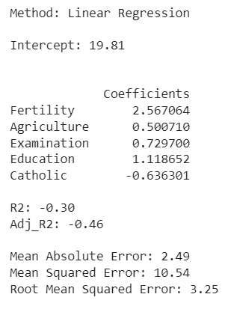
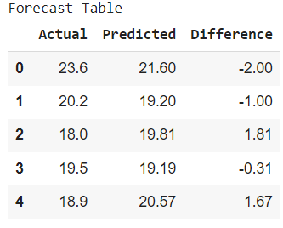
Interpretation of MLR:
The coefficients can be written in form of equation such as : InfantMortality = 19.81+(2.57*Fertility)+(0.500*Agriculture)+(0.73*Examination)+(1.11*Education)+(-0.64*Catholic)
The intercept means, the distance the line is away from center if every dependant variable is kept 0 and in this case it is 19.81 points positively away from center.our case it might not have meaningful interpretation has every dependent factors cannot be 0 at the same time.
The coefficient means the ratio of y and x-axis which is also know as slope whereas in this case, slope is ratio of independent and dependent variable. So, ratio of InfantMortality to Fertility is 2.57 which means that when fertility increases by one the InfantMortality increases by 2.57 times when rest of the dependent variables are kept same. The same logic applies with every dependent variables. The closer the value of ratio to 1, linear relation the variables follows for eg. The ratio between Education & InfantMortality is very slightly more than 1 which means if the education is rose by unit time, the InfantMortality will rise by 1.11 times and if catholic if increased by one time the mortality rates decreases by 0.64 times.
The negative R² and adjusted R² Score describes that the independent variables we used for this research are not appropriate to explain the variability of the dependent variables. They scores are -0.30 and -0.46 respectively. The R² score > 0.90 is generally accepted and for adjusted R² Score, greater than 0.5 is accepted.
The MAE, MSE and RMSE value are 2.49, 10.54, 3.25 respectively. These metrics are used to evaluate the performance of deployed algorithm, basically they calculate the error between actual and predicted values and lower the value is, more efficient the algorithm is. Whereas in our case the value of MSE is very high and values of MAE & RSME is not lower which means that our algorithm is not very efficient.
Looking at the forecast table, the predicted values are very near to actual values, in some case the difference is less than 0.5 which is a good thing but the problem is the model is not sensitive enough to predict any outliers. For instance, algorithm predicted the values between 19.20 and 21.60 which is very much near to mean of InfantMortality 20.00.
Fig. 8 – MLR results
Fig. 9 – Forecast Table

Slide 7
Ways to improve model:
The data collected should also contains health related features such as number of childcare hospitals, Hospital hygiene, Women hygiene, number of hospital in that area, disease outspread data, family income data, number of hours a mother works after a child is born, whether the baby born was natural or C-sect.
For such complex predicting model where dataset possesses nonlinear relationship, algorithm such as Random Forest, Neural Network should be deployed.
The dataset is much small, large number of datapoints should be available rather than just 47 datapoints.
There are some coefficient which don’t seem logical such as when Catholic increases InfantMortality decreases.

